Slide 1

Shipston-on-Stour Car Parking Study
Mike King
Director
People and Places Insight Limited
Mike.king@people-places.co.uk
07788286337

Slide 2
What we do
Benchmarking
Car Parking
First Time Visitor Reviews
Signage Reviews
Neighbourhood Planning

Slide 3
What we do
Provide a detached impartial evidence base to separate perception and reality
Provide the data if there is scope for further investigation with specialists in car parking

Slide 4
What we don’t do
Provide recommendations in terms of pricing, policy and provision

Slide 5
How we have helped
Knaresborough
Henley on Thames
Bury St Edmunds
Marlborough

Slide 6
Structure
30 mins
Perception of Issues
Methodology of Car Parking Study
Results
Moving Forward
Questions/ Answers

Slide 7
Q: WHAT ARE THE ISSUES IN SHIPSTON-ON- STOUR TOWN CENTRE?

Slide 8
What are the negative aspects of the Town Centre? | National Small Towns % | National Large Towns %
Physical appearance | 22 | 21
Prosperity of the town | 29 | 20
Labour Pool | 14 | 19
Geographical location | 7 | 3
Mix of Retail Offer | 21 | 21
Number of Vacant Units | 41 | 46
Potential tourist customers | 11 | 11
Potential local customers | 3 | 3
Affordable Housing | 10 | 18
Transport Links | 14 | 15
Footfall | 20 | 16
Car Parking | 50 | 48
Rental Value/ Property costs | 29 | 34
Market(s) | 10 | 5
Local business competition | 17 | 16
Competition from other localities | 25 | 26
Competition from out of town shopping | 40 | 37
Competition from the internet | 37 | 47
Events/ Activities | 7 | 7
Marketing/ Promotions | 5 | 6
Local Partnerships/ Organisations | 2 | 4
Other | 6 | 12

Slide 9
What are the negative general aspects of the Town Centre? | National Small Towns % | National Large Towns %
Physical appearance | 37 | 30
Cleanliness | 25 | 31
Retail Offer | 53 | 42
Customer Service | 9 | 8
Cafes/ Restaurants | 20 | 5
Access to Services | 13 | 5
Leisure Facilities | 25 | 9
Cultural Activities/Events | 19 | 9
Pubs/ Bars/ Nightclubs | 22 | 10
Public Toilets | n/a | n/a
Transport Links | 15 | 12
Ease of walking around the town centre | 6 | 5
Convenience e.g. near where you live | 4 | 5
Safety | 12 | 7
Car Parking | 39 | 41
Markets | 25 | 9
Other | 16 | 17

Slide 10
Q: HOW WOULD YOU RATE CAR PARKING IN THE TOWN CENTRE?
Provision-No of spaces
Availability- No of spaces available
- Compared to other towns
Signage
Pricing

Slide 11
Why Research
Perception versus Reality
Evidence Base
Understand the Problem
Move Forward
Baseline for Further Measurement

Slide 12
Process
Advanced Lambeth Study Methodology
Three Visits:
Tuesday 21st November 2017
Friday 8th December 2017
Saturday 9th December 2017
Boundary definition supplied by Town Council

Slide 13
Process
Mill Street Car Park | Total No. of Spaces | % of spaces | Total No. of Spaces Vacant 0800 | Vacancy % | Total No. of Spaces Vacant 0900 | Vacancy % | Total No. of Spaces Vacant 1000
SS | 0 | 0 | 0 | 0 | 0 | 0 | 0
LS | 23 | 96 | 16 | 70 | 6 | 26 | 3
DS | 1 | 4 | 1 | 100 | 1 | 100 | 1
TOTAL | 24 | 100 | 17 | 71 | 7 | 29 | 4

Slide 14
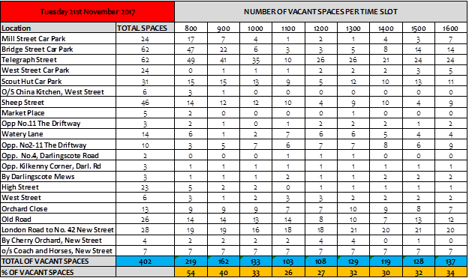
Process

Slide 15
Analysis
Vacancy per Day/ Car Park/ Time Slot
Vacancy by Day/ Time Slot
Off Street Vacancy per Day/ Car Park/ Time Slot
Benchmarking Analysis

Slide 16
Overall Vacancy Rates by Day/ Time Slot
Notes:
During both weekday counts vacancy levels in the defined town centre area were lowest during the 11.00-12.00 slot, 26% on Tuesday 21st November 2017 and 22% on Friday 8th December 2017. On Saturday 19th December 2017 the vacancy rate reached its lowest at 12.00-13.00 with a figure of 24%.

Slide 17
Aggregate Vacancy Figures
The aggregate figure of all vacant space counts across all nine time slots was lower on Saturday 9th December 2017 with a figure of 1,202 compared to 1,218 on Friday 8th December 2017 and 1,339 on Tuesday 21st November 2017.

Slide 18
Off Street Vacancy Rates

Slide 19
Off Street Vacancy Rates
On Tuesday 21st November 2017 between 11.00-12.00 in Mill Street Car Park only 1 space vas vacant, 3 in Bridge Street Car Park and 1 in West Street.
On Friday 8th December 2017 between 11.00-12.00 there were only 3 spaces available in the Mill Street Car Park, Bridge Street Car Park and West Street Car Park combined.

Slide 20

The strange case of Telegraph St. Car Park

Slide 21
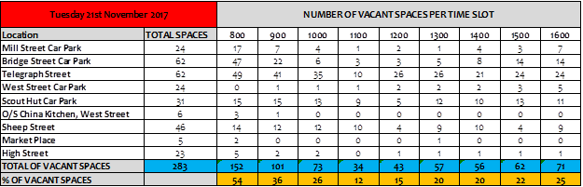
Benchmarking Boundaries

Slide 22
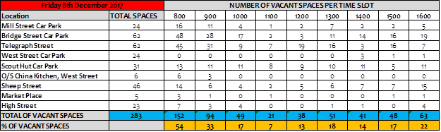
Benchmarking Boundaries

Slide 23

Benchmarking Boundaries

Slide 24
Benchmarking Time Frames
TIME SLOT | Bench. | 1100 | 1200 | 1300
Tuesday 21st November 2017 | 37 | 12 | 15 | 20
Friday 9th December 2017 | 31 | 7 | 13 | 18
Saturday 10th December 2017 | n/a | 20 | 16 | 16

Slide 25
Moving Forward
British Parking Association Conference figure of 15%
Overall Weekday Pinch Point between 11.00-12.00
The first time visitor would not be aware of Scout Hut Car Park
The strange case of Telegraph Street
Weekday Benchmarking Area and Timings highlight a low vacancy rate (especially compared to National Benchmarking averages)
Pinch points during the weekdays, Bridge Street, Mill Street and West Street provide very few vacant spaces

Slide 26
Moving Forward
Marlborough/ Bradford-on-Avon
Shipston-on-Stour Housing Developments?

